Slide 1

Shadan Institute Of Management Studies For Boys
Topic- Transportation problem
(Operations Research )
Name- SYED SAMEER
Hall Ticket no- 141721672007
Faculty In-charge Name- SAJEED SIR & HENA Madam

Slide 2
TRANSPORTATION PROBLEM
Introduction to Transportation Problem:-
→Transportation problem is one of the method used to solve linear programming problems.
→Transportation problem is an allocation method applied to a lot of practical problems.

Slide 3
METHODS TO FIND IBFS
The various methods to find Initial Basic Feasibility Solutions ((IBFS) to a transportation Problems are:-
North West Corner Method (NWCM)
Row Minimum Method (RMM)
Column Minima Method (CMM)
Least Cost Method (LCM)
Vogel’s Approximation Method (VAM)

Slide 4
North West Corner Method (NWCM)
The steps involved in finding IBFS through NWCM are as follows:-
→The cell (1, 1) in the North West Corner (i.e., upper left) of the transportation matrix is chosen first and as many units as possible is allocated to the cell. This will be equal to the minimum of available supply and demand requirement. Adjust the supply and demand as per the allocations made.
(a) If the supply for the first source (row) is exhausted then move vertically down and make allocation in the second row and first column i.e., cell (2, 1) and repeat step-1.
(b) If the demand for the first destination (column) is exhausted, then move horizontally and make allocation in the first row and second column i.e., cell (1, 2) and repeat step-1 for further allocation.
(c) If both supply and demand are exhausted, then move diagonally and make allocation in the second row and second column i.e., cell (2, 2).

Slide 5
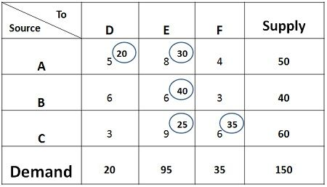
North West Corner Method (NWCM)

Slide 6
Row Minima Method (RMM)
The steps involved in finding IBFS using Row Minima Method:-
→Allocate in the lowest cost cell in the first row as it is row minima method till the capacity of the row 1 is exhausted or deleted or requirement at the distribution centre is satisfied or both. The following three cases may arise.
(a)If the capacity related to first row is exhausted then shift towards 2nd row.
(b) If requirement at the destination is satisfied, delete the destination and reconsider the remaining capacity of the 1st row.
(c)If both the capacity of source 1 or row 1 and the destination satisfy the condition then it requires to make a zero allocation to next smallest cell of the first row. Delete the row and the 7th column. The process will continue until rim conditions are satisfied.

Slide 7
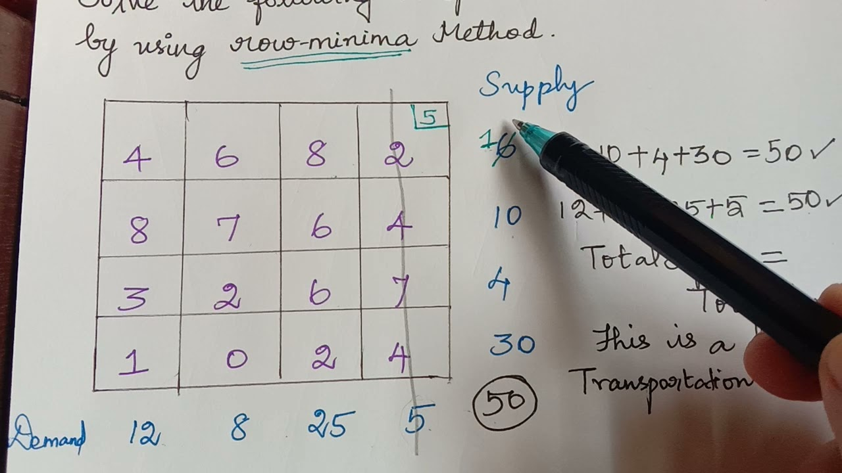
Row Minima Method (RMM)

Slide 8
Column Minima Method (CMM)
The steps involved in finding IBFS using Column Minima Method are:-
→Allocate to the lowest cost cell of the first column in such a way that either first distribution center is fulfilled or capacity of the nth source is exhausted. The three cases which arises in Column Minima Method are as follows,
(a) If the first distribution center is satisfied with requirement available then first column gets deleted.
(b) If the capacity of the source fulfills then throw gets deleted. Reconsider the first column with the left out requirement.
(c) If both the requirements such as first destination and the source fulfills the condition then make zero allocation the next least cost cell of the first column. Delete both column and throw and move right to the second column.

Slide 9
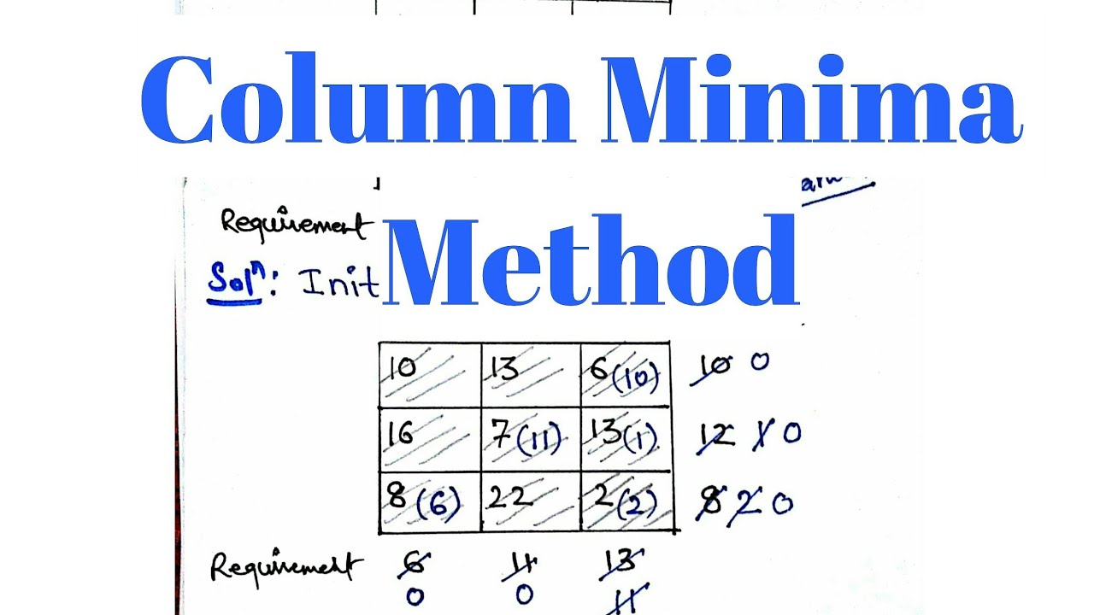
Column Minima Method (CMM)

Slide 10
Least Cost Method (LCM)
Least Cost Method (LCM) or Matrix Minimum Method:-
Least Cost Method is also known as Matrix minimum method or Lowest Cost Entry Method. To achieve the objective of minimum transportation cost, this method consider routes (or cells) with least unit.
The steps involved in finding IBFS using LCM are as follows:-
→The cell with the smallest unit cost of transportation is chosen and as many units as possible are allocated to that cell. If there is a tie in the least cost, the cell where maximum allocation is possible is chosen.
→Adjust the supply and demand for the allocation made and eliminate (strike out) the row or column in which either supply or demand is exhausted. If both are exhausted simultaneously, then only one can be eliminated.
→Repeat steps (1) and (2) with the next smallest unit cost of transportation among the remaining cells cells).

Slide 11
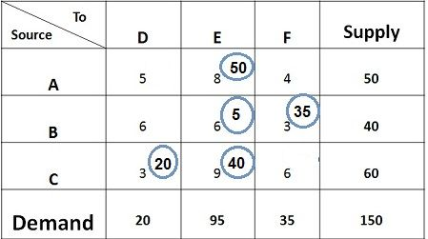
Least Cost Method (LCM)

Slide 12
Vogel’s Approximation Method (VMM)
Vogel's Approximation Method (VAM) :-
VAM or Vogel's approximation method is also known as 'Penalty or Regret Method" It is basically a heuristic method. Allocation is done on the basis of opportunity cost (penalty) that would have incurred if allocation in some cells with lowest costs were missed.
The procedure/steps involved is finding IBFS using VAM are as follows:-
→Compute the penalties for each row and column by taking the difference between the smallest and next smallest unit transportation cost in that particular row or column.
→Choose the row or column with highest penalty and allocate possible value in the cell having the least cost in the selected row or column. If a tie occurs in the penalties, select the one which has the minimum cost . If there is a tie in the minimum cost also, select that row/column which will have maximum possible allocation.

Slide 13
Vogel’s Approximation Method (VMM)
→Adjust the supply and demand for the allocation made and eliminate (strike out) the row or column in which either supply or demand is exhausted. If both row and column value become zero at the same time, then either row or column has to be eliminated and remaining row (or column) has to be assigned with zero supply (or demand)
→Recompute the penalties for the remaining rows and columns (uncrossed rows and columns).
→Repeat step-1 to step-3 until and unless all the available supply at various sources and entire demand various destinations are satisfied.

Slide 14
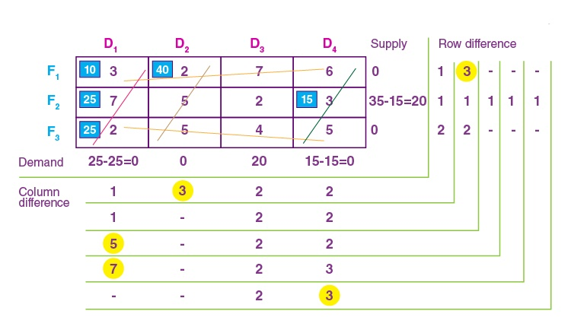
Vogel’s Approximation Method (VMM)

Slide 15

THANK YOU FOR Giving This Opportunity

